Slide 1

Dining+
Notes:
garrett

Slide 2
Overview
Meal ordering system inspired by University dining halls
Students can login and order meals from a given menu
Admins can schedule the menu and see orders coming through
Dining+
Notes:
garrett

Slide 3
Backend
Database Schema
Noteworthy Gems
Devise
Twilio
Students
Admins
Meals
tlsmail
Figaro
Orders
Dining+
Notes:
matt

Slide 4
Agile Development
Sprint 1
SCRUM Meetings
12
Sprint 2
Monday
1 hour
Pivotal Tracker
29
Sprint 3
Wednesday/Friday
20 min.
29
GitHub
2 Required Approvals
Separated workflow to avoid merge conflicts
Dining+
Notes:
sarah

Slide 5
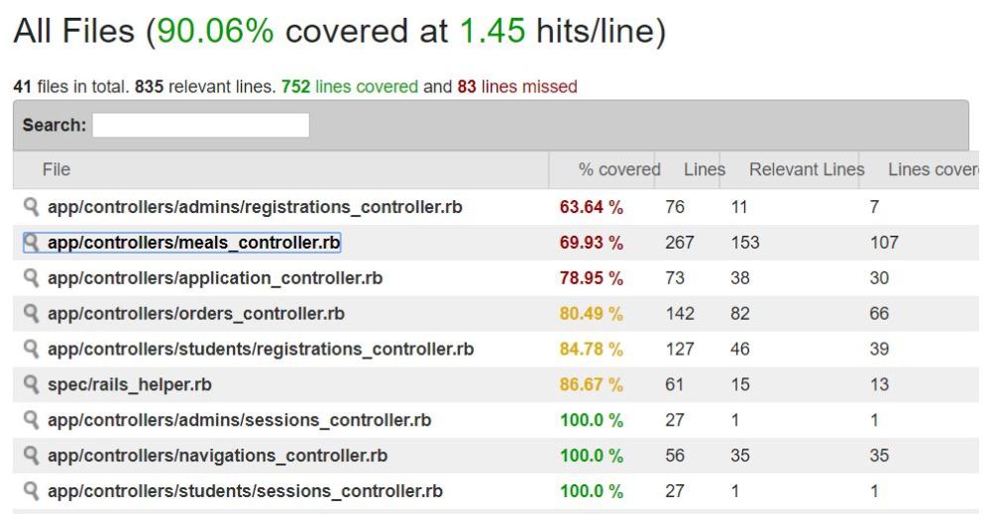
Testing
Test Driven Development
Behavior Driven Development
Code coverage > 90%
Cucumber/Capybara
Dining+
Notes:
Heather and garrett

Slide 6
Lessons Learned
Flexibility
Strict Schedule and Standards
Communication
Dining+
Notes:
rachel

Slide 7
Features / Demo
Dietary Restrictions
JavaScript/AJAX
Sorting/Filtering
Text Notifications
Menu Scheduling
Dining+
Notes:
heather and rachel

Slide 8
Questions

Slide 9
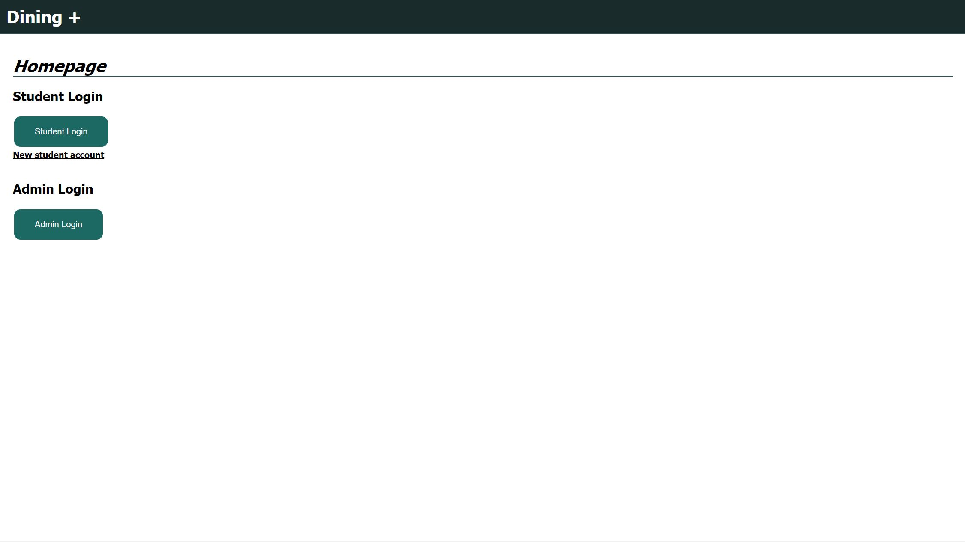
Demo Screenshots
Main Login Screen
Dining+

Slide 10
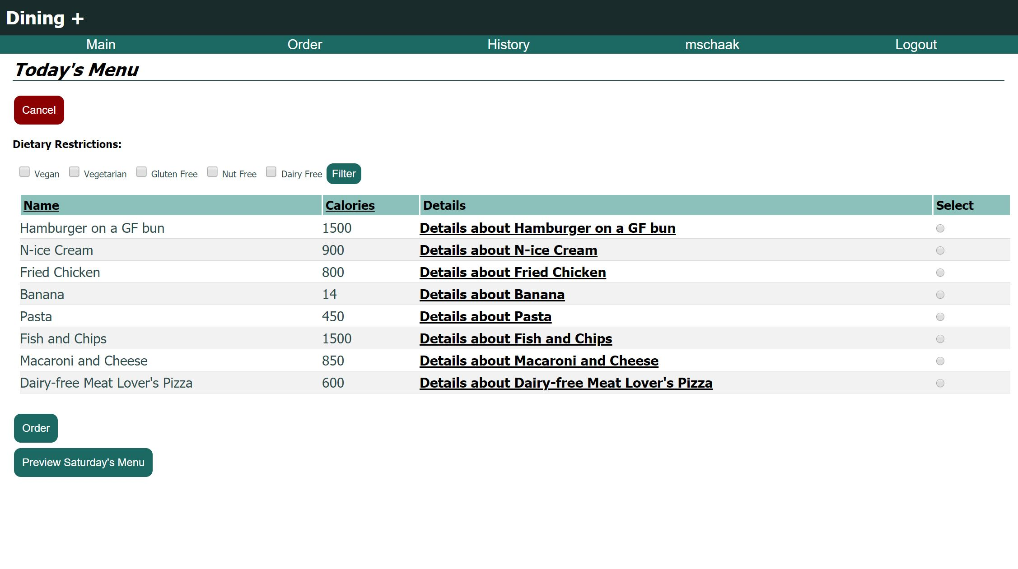
Student Order Screen

Slide 11
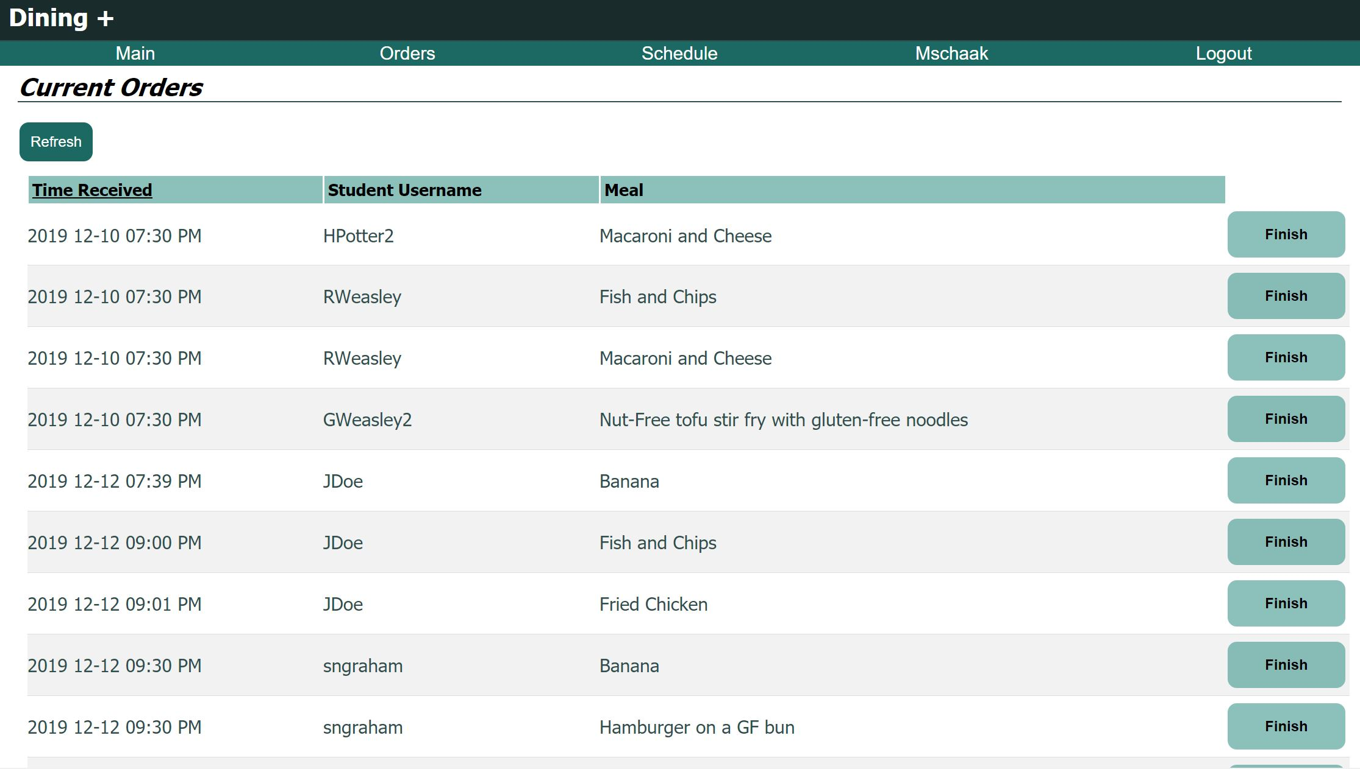
Admin Order Page

Slide 12
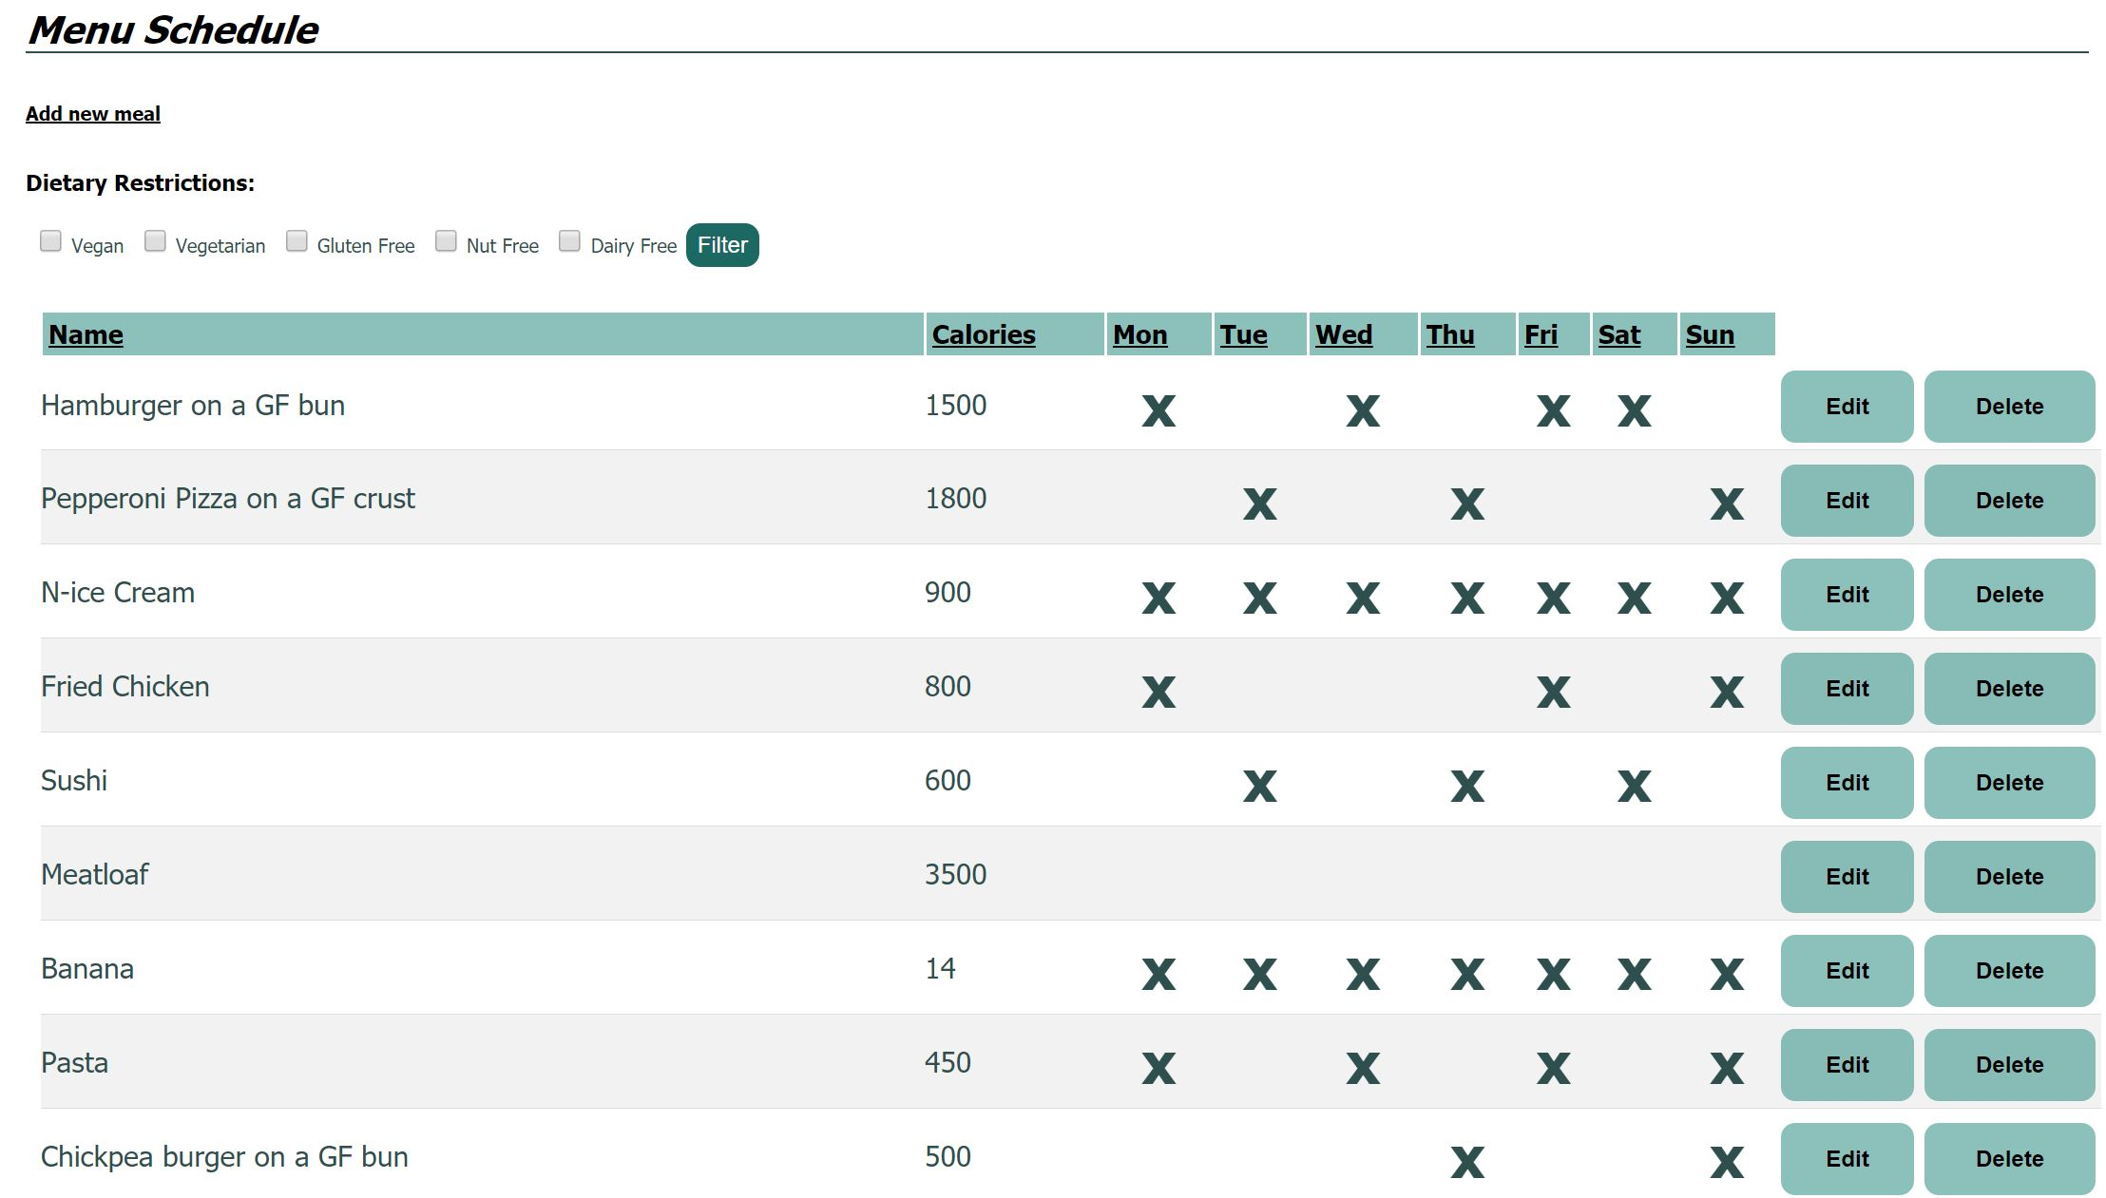
Admin Scheduling Page

